Slide 1
SoC
and how to use them
Speakers: Deepesh Padala, Devanshu Sharma, Roshan Teja
Coordinator: Pranav Singh

Slide 2
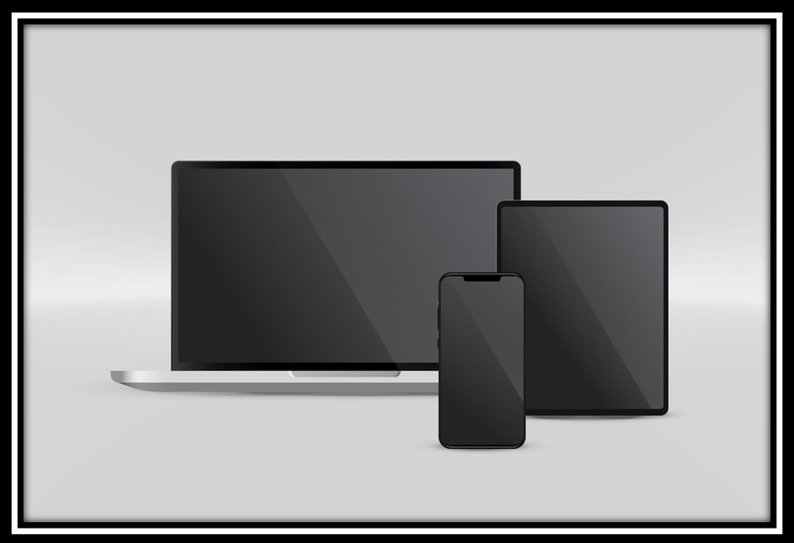
Introduction to SOCs
SOCs Stand for a system on a chip
Let’s try find answers to these questions:
Compacts Devices such as smartphones and Tablets can do almost all the tasks which a Desktop can perform.
Are the Processor used in Laptops and Mobile phone exactly same?
3) What is the ARM architecture?

Slide 3

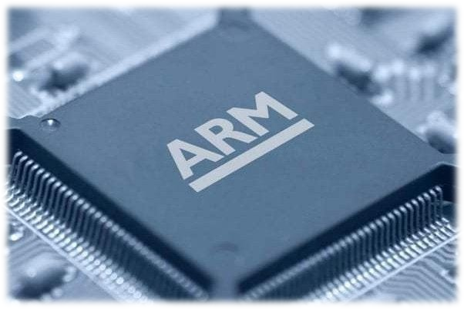
How is it possible to integrate all the parts inside a single chip?
Processors using ARM architecture
Operating system
Integrate more and more transistors inside the same area.

Slide 4
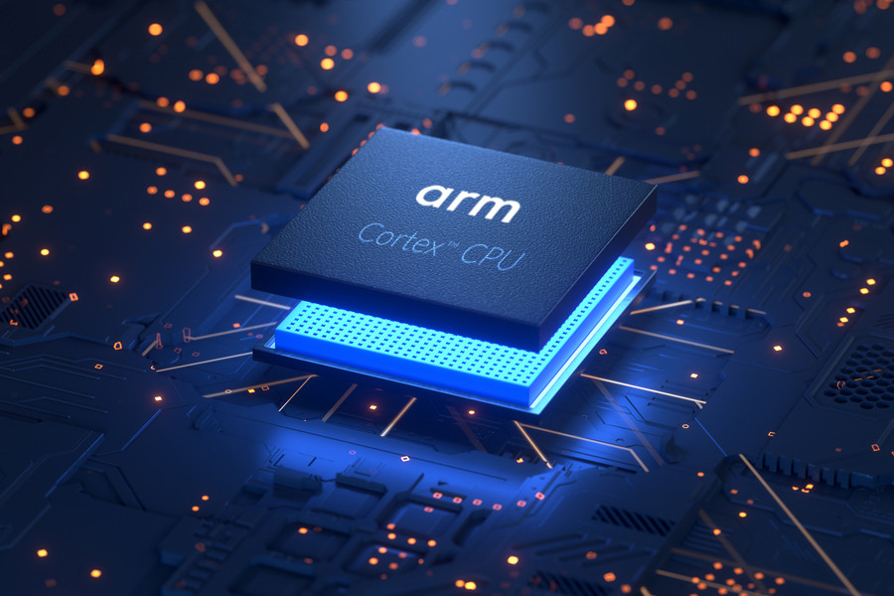
ARM Architecture
Arm stands for Advanced RISC Machines (ARM).
Arm is a family of Reduced Instruction Set Computing (RISC) architectures for computing processors.
Arm develops the architecture and licenses it to other companies, who design their own products that implement one of those architectures‍, Including systems-on-chips (SoC) and systems-on-modules (SoM) that incorporate different components such as memory, interfaces.

Slide 5
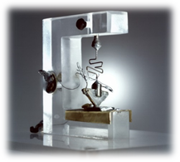
History of SOCs
World’s first transistors:
Now let’ see how far we have come since the development of the first transistor.
Bell Laboratories in Murray Hill, New Jersey
December 23, 1947

Slide 6
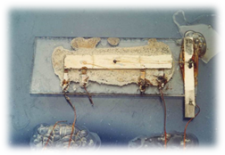
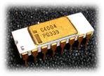
World’s first IC:
Developed by Jack Kilby in 1958
World’s first Processor (The Intel 4004 )
Released in March 1971 (2300 transistors)

Slide 7
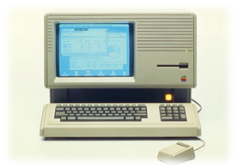
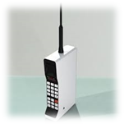
World’s first Personal Computer(Altair):
Developed in 1974.
World’s first Mobile Phone (DynaTAC 8000X )
Released in September 21, 1983

Slide 8
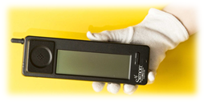
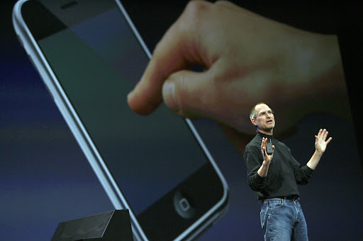
World’s first smartphone
Went on sale in 1994
First iPhone
Went on sale June 29 2007:

Slide 9
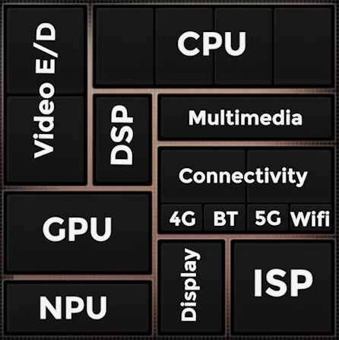
Main Parts In SoC

Slide 10
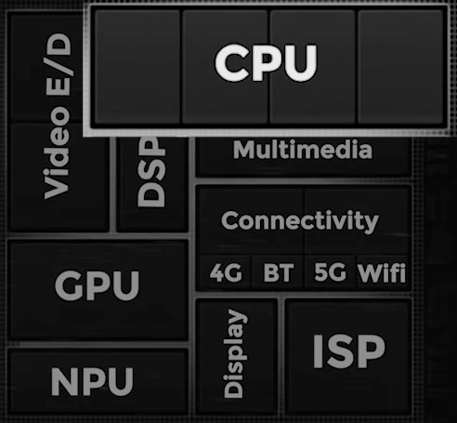
CPU
Prime
Perfomance
Perfomance
2.8 GHz
2.4 GHz
2.4 GHz
Efficiency
Efficiency
Efficiency
1.8 Ghz
1.8 Ghz
1.8 Ghz

Slide 11
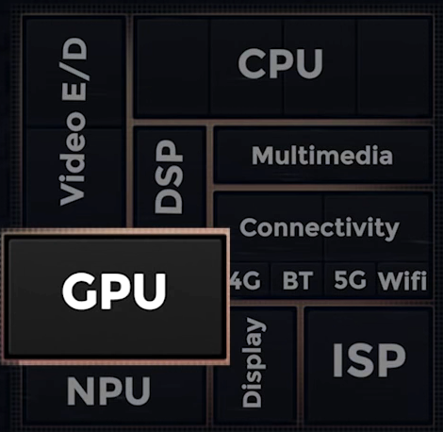
Graphics Processing Units

Slide 12
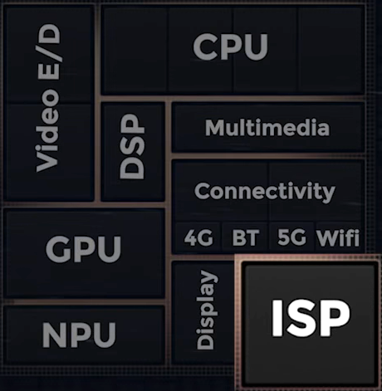
Image Signal Processing Units

Slide 13
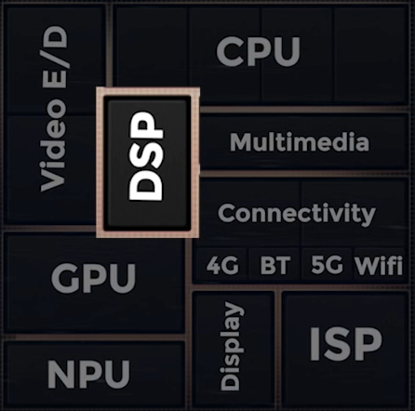
Digital Signal Processing Units

Slide 14
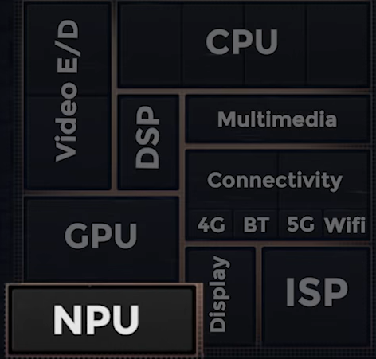
Neural Processing Units

Slide 15
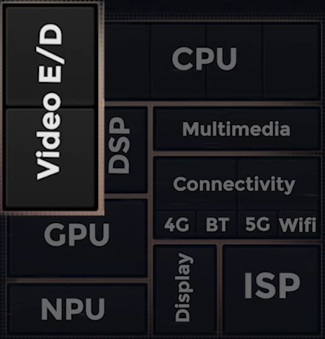
Video E/D

Slide 16
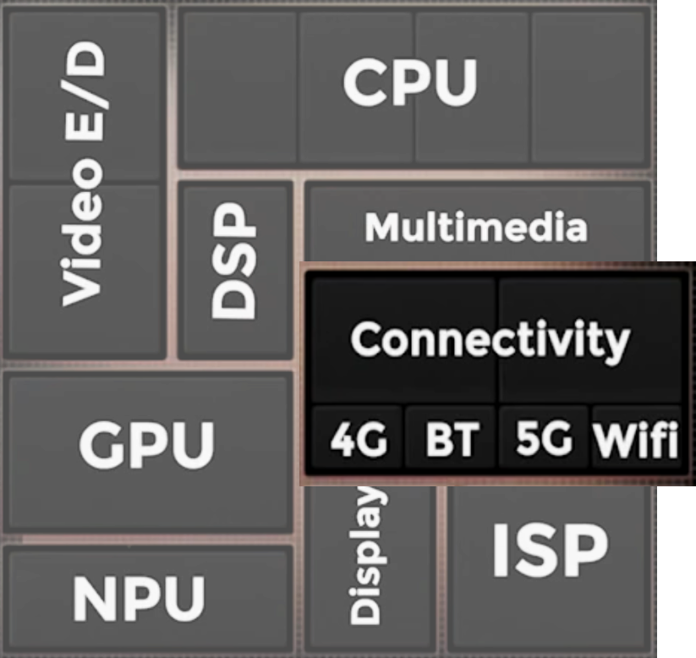
Connectivity Unit

Slide 17
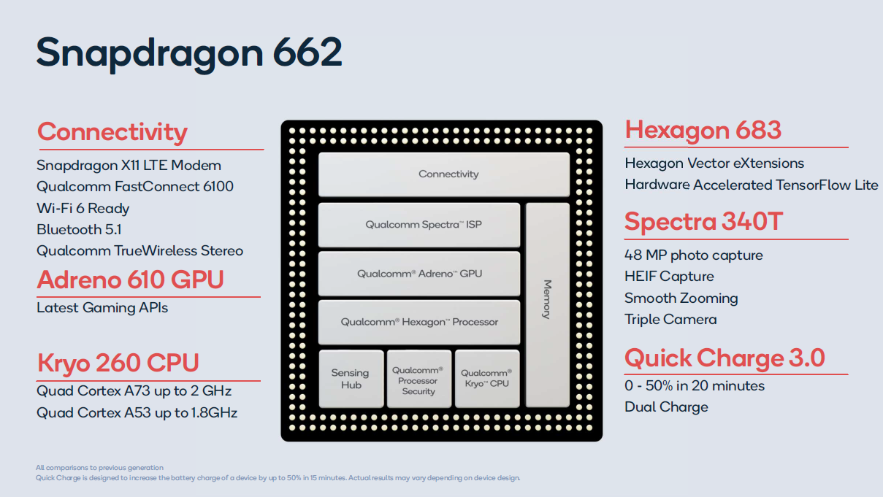
Some very common SoCs
Used in almost every smart phone in the world

Slide 18
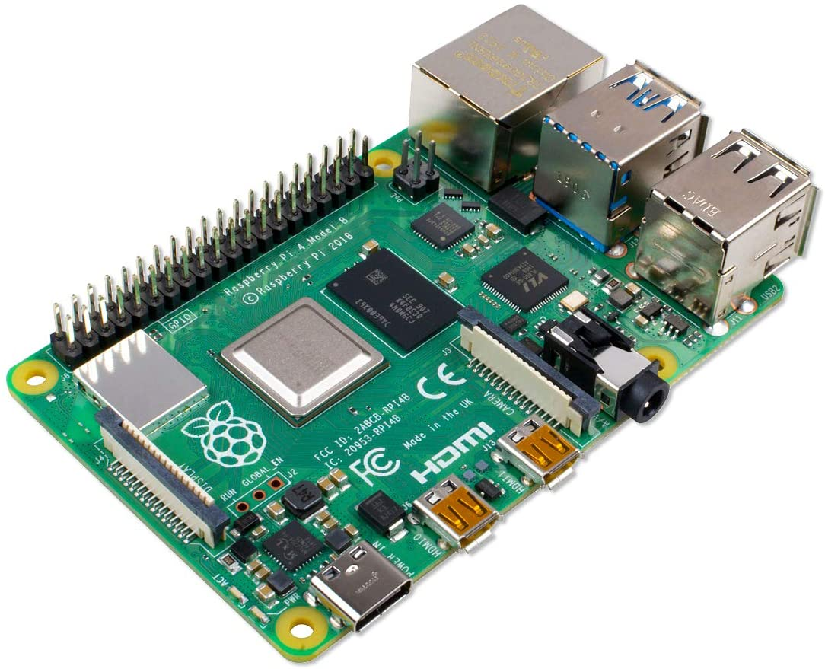
Some very common SoCs
One of the coolest computers ever made... It’s used everywhere from IOT to Robotics and Automation

Slide 19
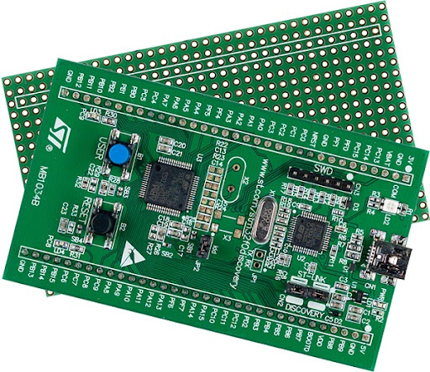
Some very common SoCs
This is an arm based microcontroller. Basically like an arduino but on steroids.

Slide 20
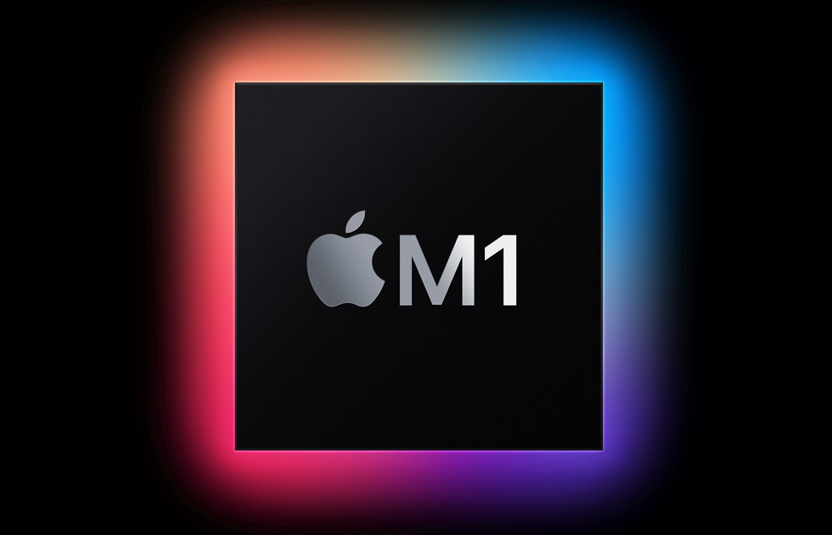
Some very common SoCs
Even apple uses it… The M1 series of SoCs are really powerful… But it’s apple… so… yeah

Slide 21
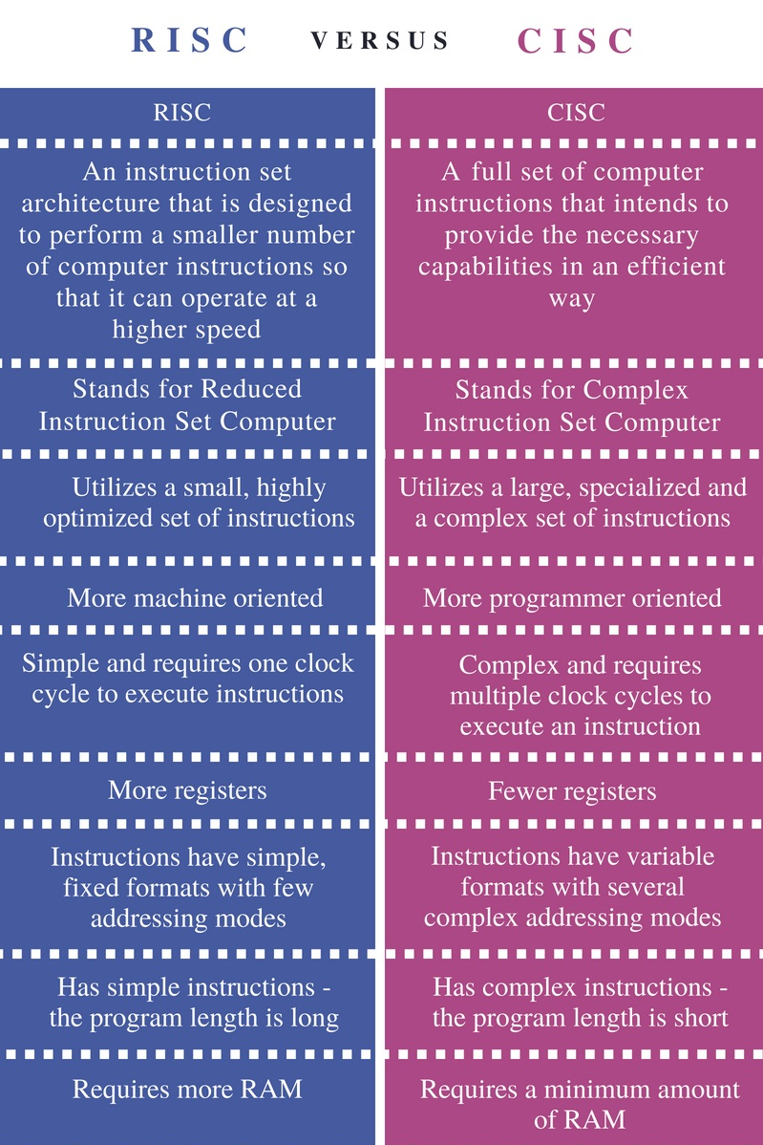
What is RISC?

Slide 22
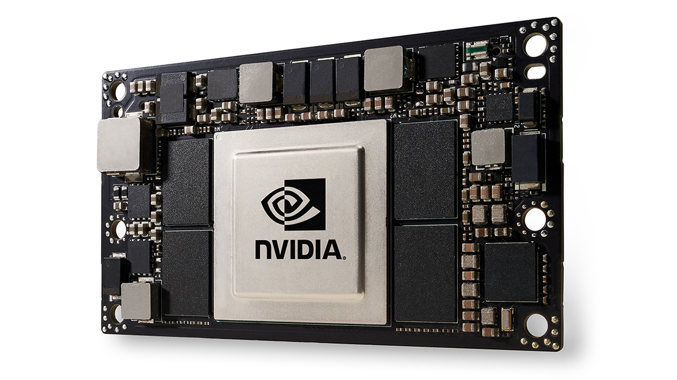
Some very common SoCs
Slightly more expensive than raspberry pis, but these have 512 cuda cores, which can run multiple neural networks simultaneously.

Slide 23
Thank You

Slide 24
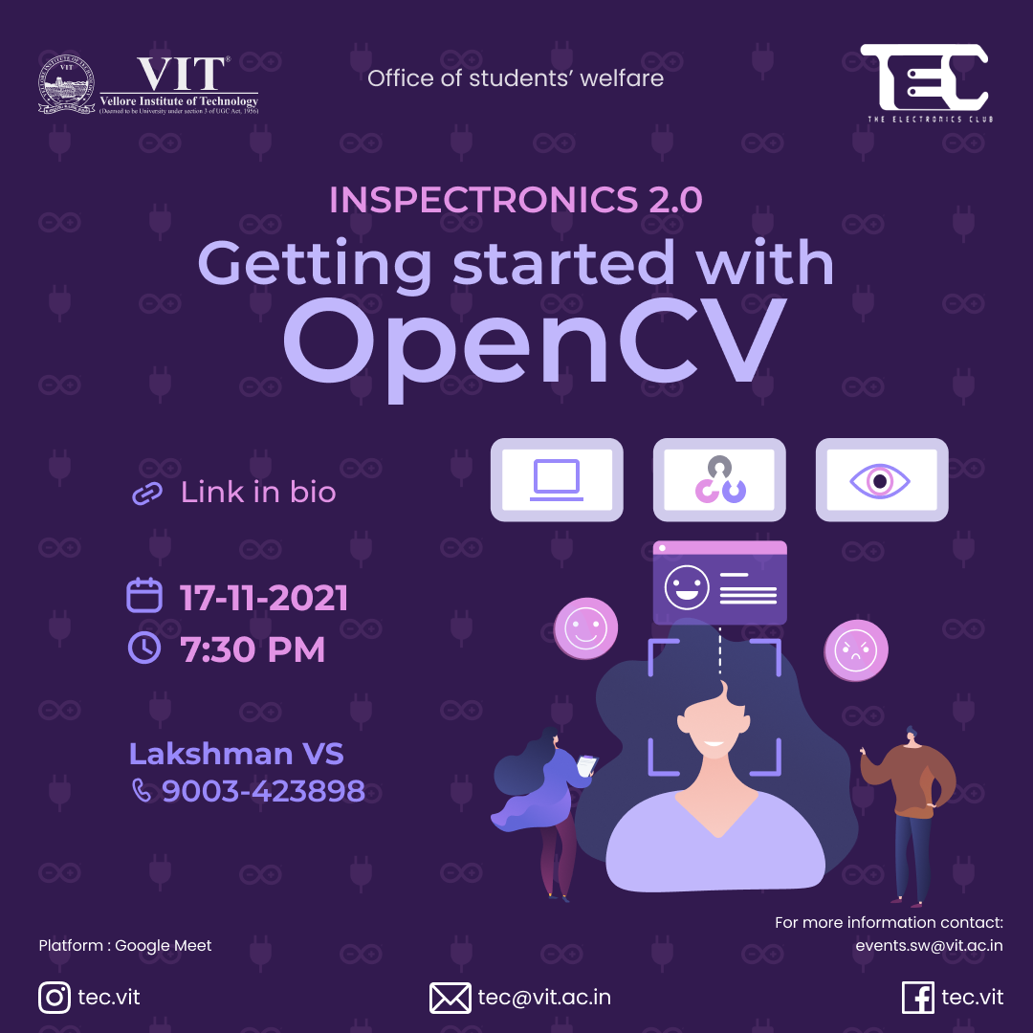
REGISTER THROUGH VTOP

